Slide 1
Unix Shell 101
GINGER Makerere training

Slide 2
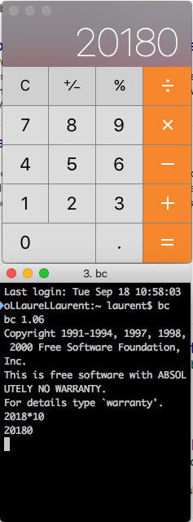
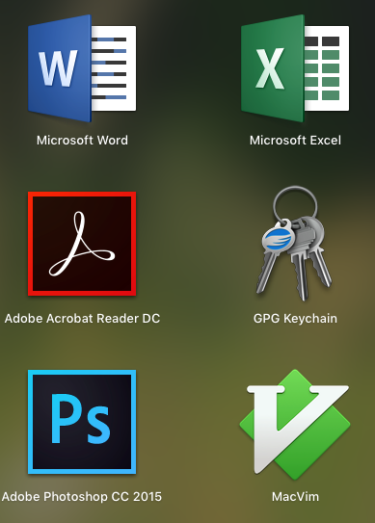
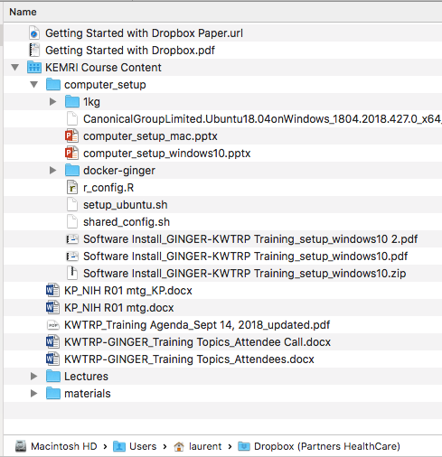
Computing basics
Interface
Programs
Data
Notes:
At a high level, computers do four things:
run programs
store data
communicate with each other, and
interact with us
They can do the last of these in many different ways, including through a keyboard and mouse, or touch screen interfaces, or using speech recognition systems. While touch and voice interfaces are becoming more commonplace, most interaction is still done using traditional screens, mice, touchpads and keyboards.
We are all familiar with graphical user interfaces (GUI): windows, icons and pointers. They are easy to learn and fantastic for simple tasks where a vocabulary consisting of “click” translates easily into “do the thing I want”. But this magic relies on wanting a simple set of things, and having programs that can do exactly those things.
If you wish to do complex, purpose-specific things it helps to have a richer means of expressing your instructions to the computer. It doesn’t need to be complicated or difficult, just a vocabulary of commands and a simple grammar for using them.

Slide 3
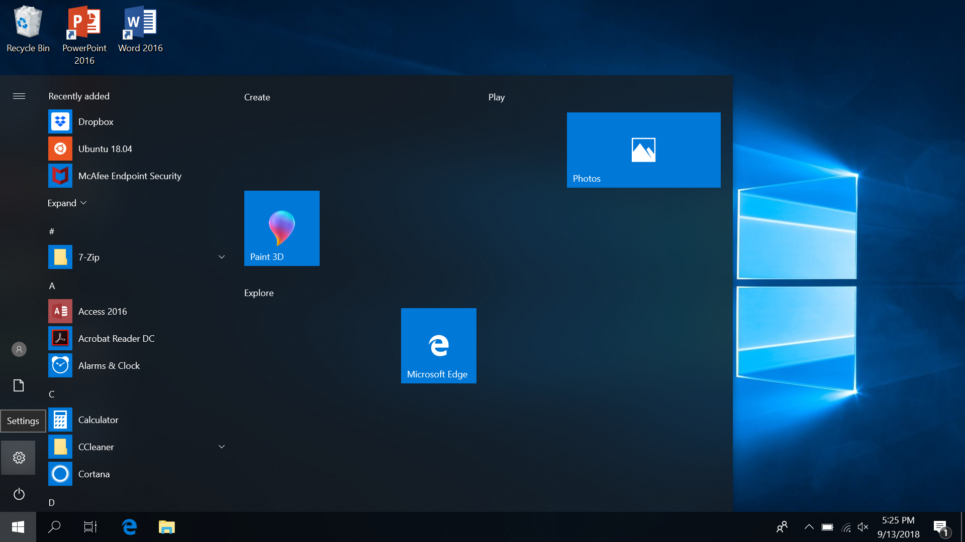
Launching a Unix Shell
Windows 10
Open the “Ubuntu” App
Mac OS
Press ⌘ + Space and then type “terminal”

Slide 4
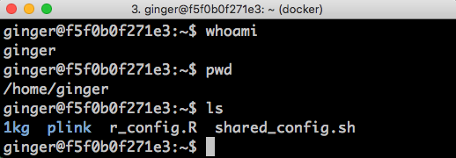
What does a Shell look like?
A command previously executed:
“pwd”
Result of “pwd” command
Prompt – waiting for the next command
Notes:
A shell is a program like any other. What’s special about it is that its job is to run other programs rather than to do calculations itself.
The last line shows only a prompt, indicating that the shell is waiting for input.
The heart of a command-line interface is a read-evaluate-print loop (REPL). It is called so because when you type a command and press Return the shell reads your command, evaluates (or “executes”) it, prints the output of your command, loops back and waits for you to enter another command.

Slide 5
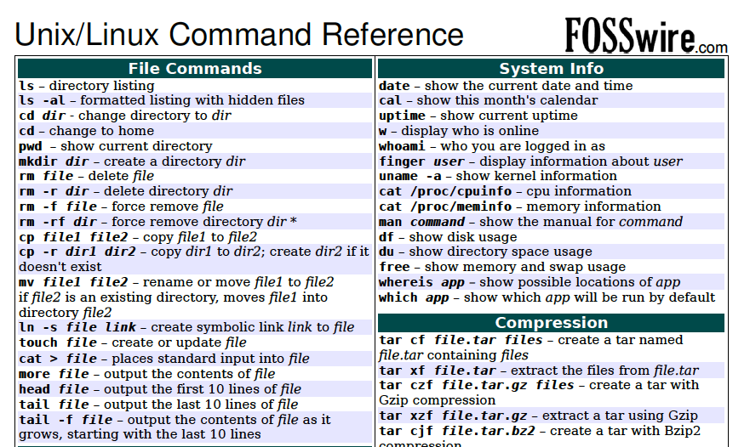
How do you know what to type in the Shell?
Notes:
It is a different model of interacting than a GUI, and that will take some effort - and some time - to learn. A GUI presents you with choices and you select one. With a command line interface (CLI) the choices are combinations of commands and parameters, more like words in a language than buttons on a screen. They are not presented to you so you must learn a few, like learning some vocabulary in a new language. But a small number of commands gets you a long way, and we’ll cover those essential few today.
Also, good to keep a cheat-sheet handy when you start!

Slide 6
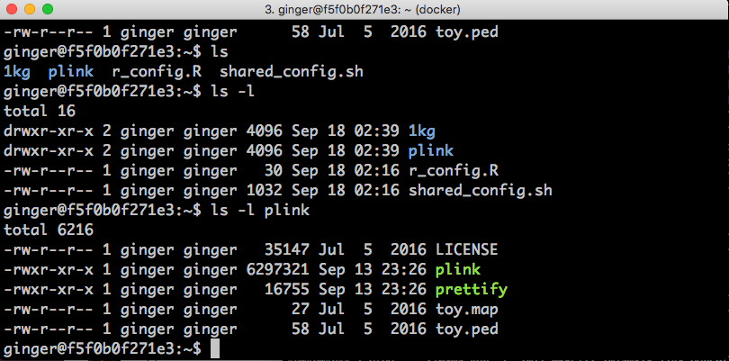
Anatomy of a Shell command
“ls” command
Result:
List files and directories in current directory

Slide 7
Anatomy of a Shell command
“ls” command
“-l” flag
Result:
List files and directories in current directory. Output is a list with details about each file/directory.

Slide 8
Anatomy of a Shell command
“ls” command
“-l” flag
Pass “plink” as argument to ”ls”
Result:
Same as “ls –l”, but now shows the content of the “plink” directory.

Slide 9
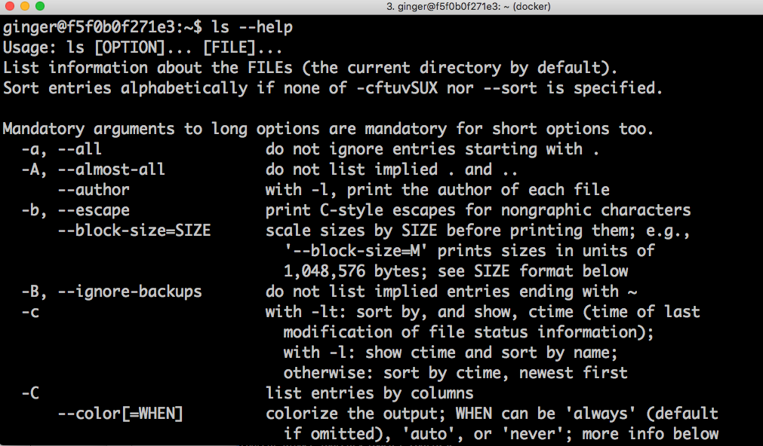
Getting help
Notes:
Explain that most command will display help using a –help flag.
Explain how to read the help

Slide 10
Interacting with the file system

Slide 11
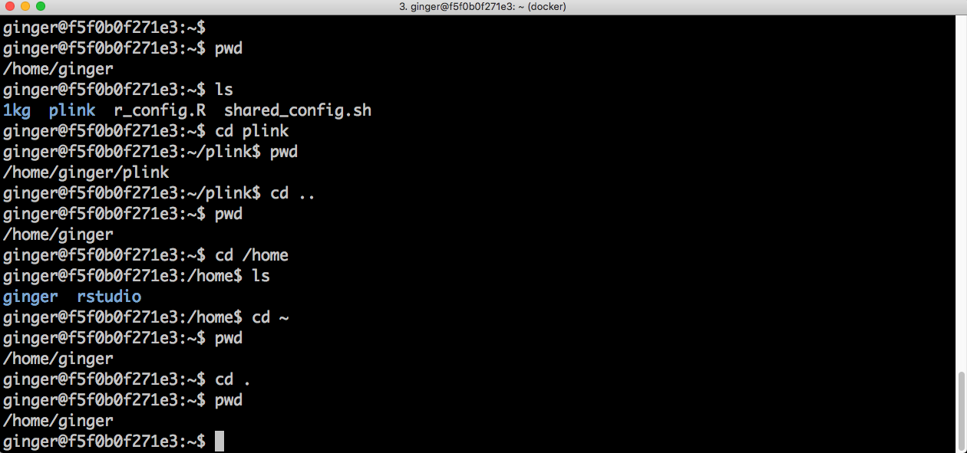
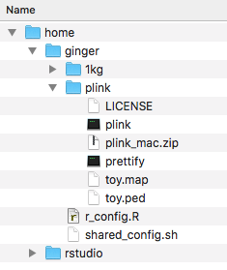
Moving around the filesystem
Notes:
Explain
pwd
ls
cd
`..`
`~`
`.`

Slide 12
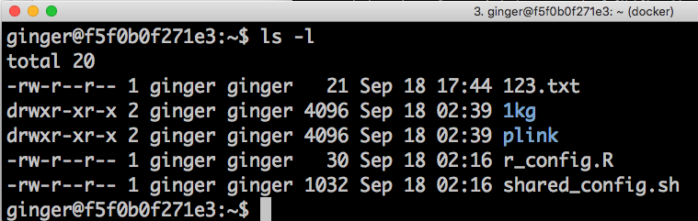
More about the filesystem and ls -l
- = file
d = directory
Permissions:
rwx r-x r-x
owner
group
size
modification date
Notes:
Explain how to read the output of ls –l. Spend a little time on permissions, although this isn’t really a topic for this course.

Slide 13
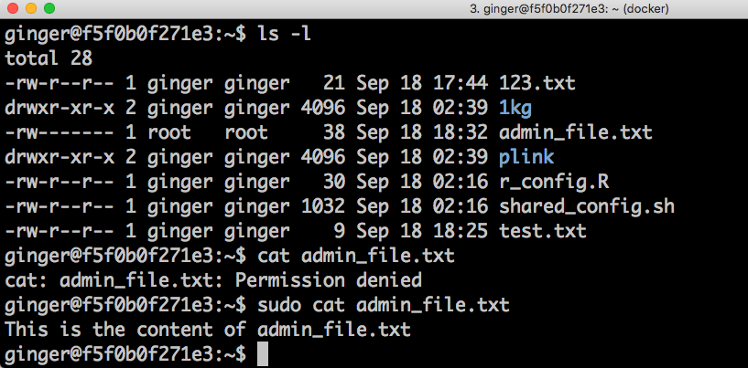
Sudo: becoming root (admin) for a command
Notes:
Briefly explain sudo. They should all have sudo rights.

Slide 14
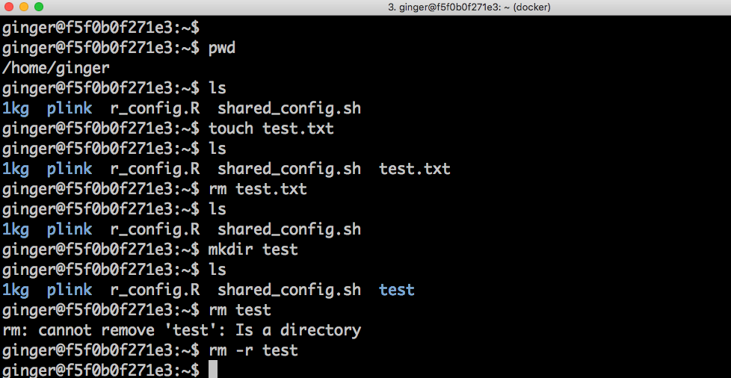
Creating / deleting files and folders
Notes:
Explain:
touch
rm
mkdir
rm –r
Make sure to mention that rm is forever!

Slide 15
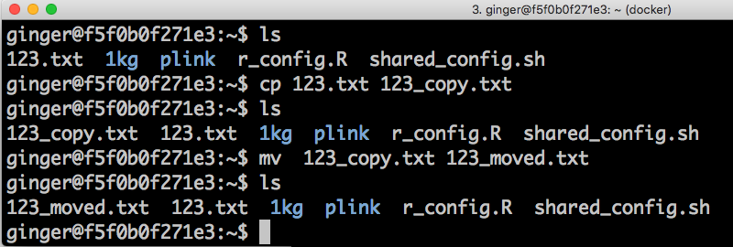
Copying and moving files
Notes:
Explain cp and mv

Slide 16
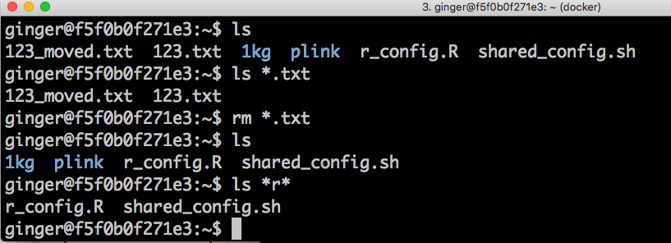
Wildcards (*)
Notes:
Explain the use of wildcards

Slide 17
Interacting with text files

Slide 18
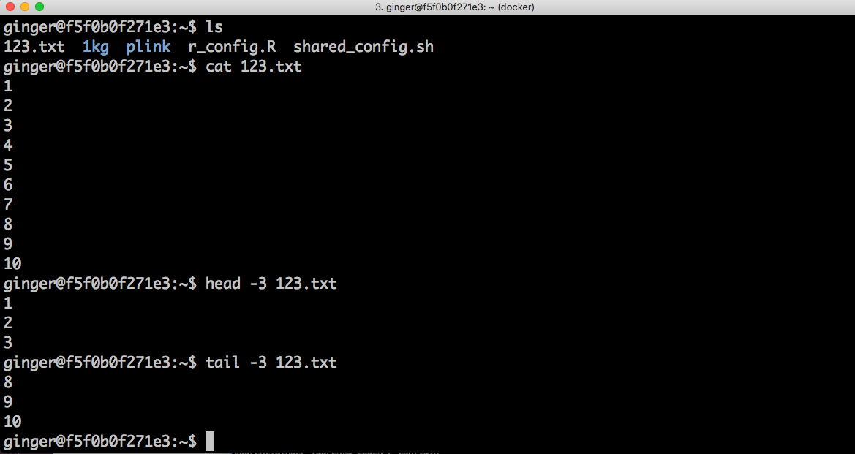
Viewing the content of a text file
Notes:
Explain
cat
head
tail

Slide 19
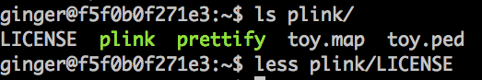
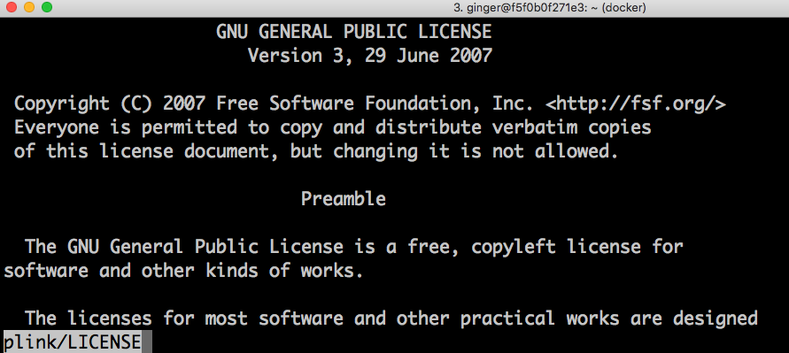
Reading longer text files: less
Commands:
q: quit
f: forward 1 page
b back 1 page
↑↓→←: move by 1 character in the direction of the arrow
/text: search for “text”
-S <enter>: chop long lines
100g: Go to line 100
Notes:
Note: Mac users with docker do not have less installed :(
Need to run sudo apt-get install less

Slide 20
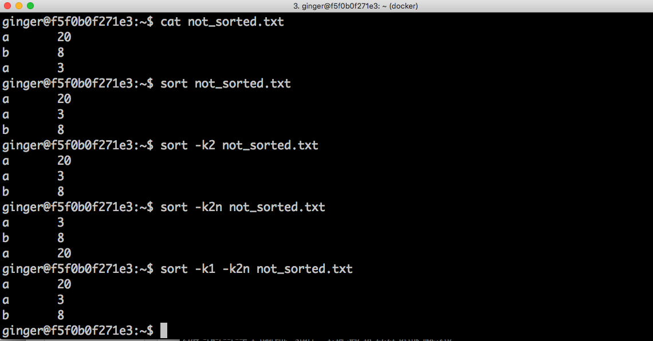
Sorting text files: sort

Slide 21
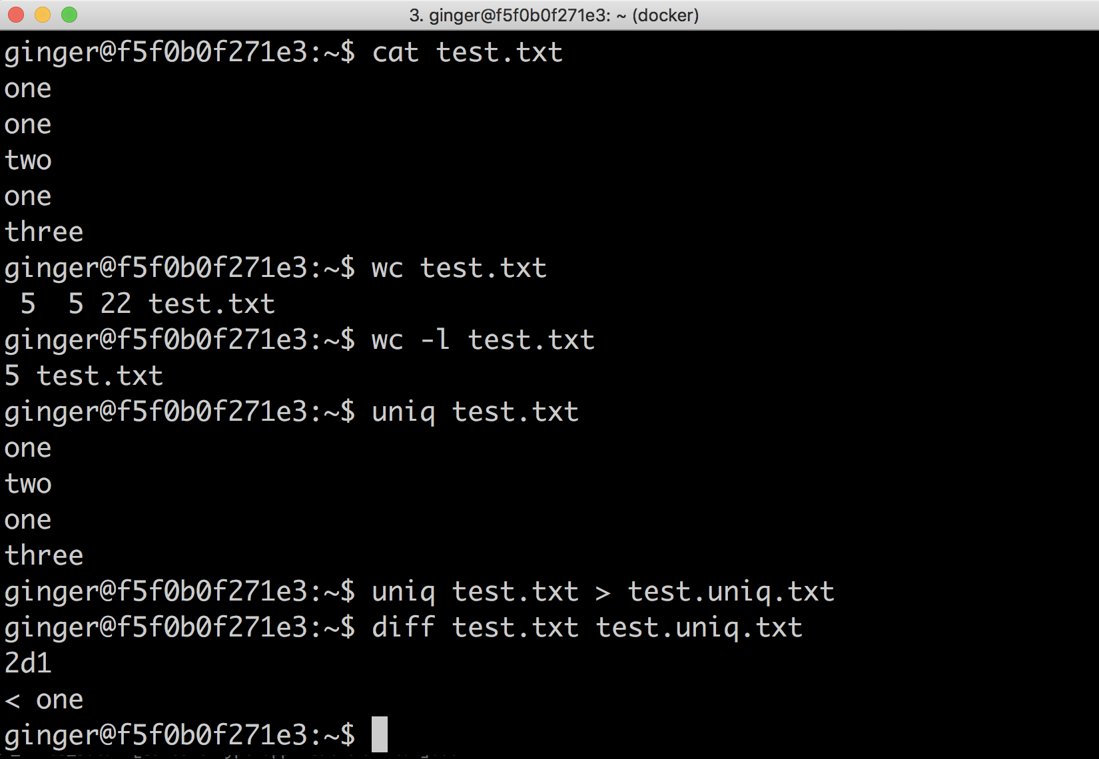
More text utilities: wc, uniq and diff

Slide 22
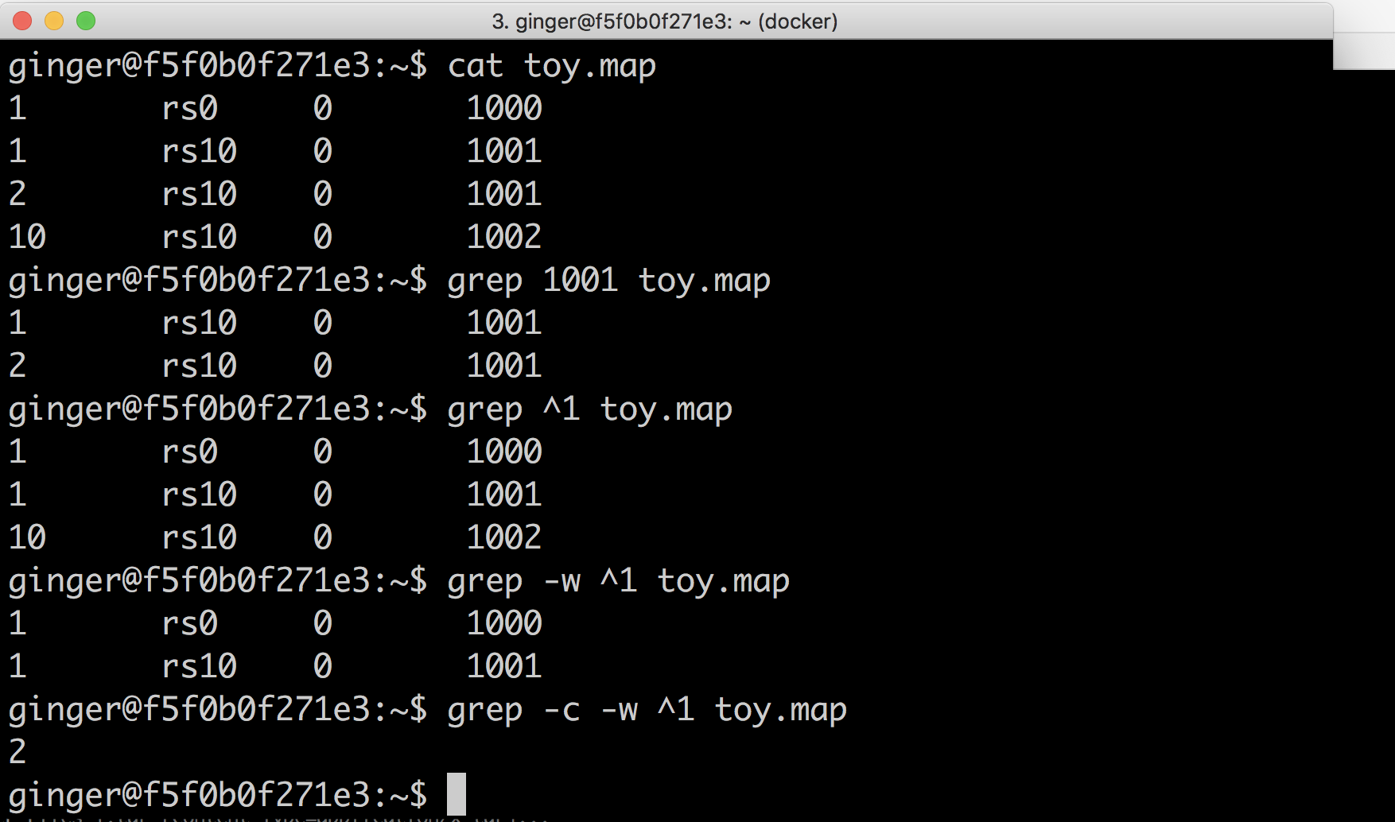
Searching a text file: grep (basic)
Notes:
Super basic grep

Slide 23
Looking for a file within a subdirectory: find
Go into a directory and try:
find .
Maybe you know what the name is:
find . -name “myfile.txt”
Maybe you just know the extension:
find . -name “*.R”

Slide 24
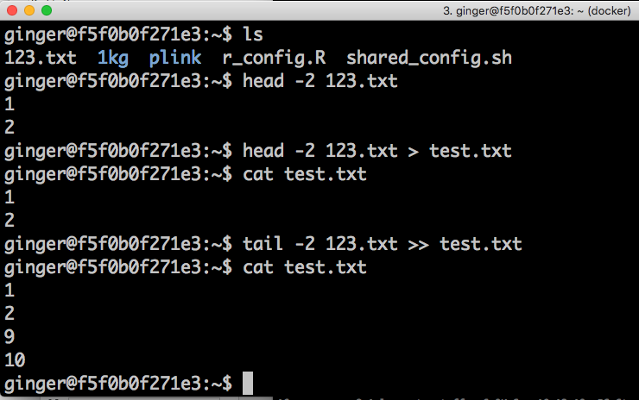
Redirecting output to a text file
Notes:
Explain > and >>

Slide 25
Looking back at your old commands
Run the command: history

Slide 26
Compressing text data

Slide 27
gzip everything!
There are many algorithms for file compression. gzip is the most popular in the unix world
Achieves compression of 1/10th to ½ file size
Many languages can read gzip files natively – and often faster!
Python: gzip.open(“file.gz”)
R: read.table(‘file.gz’)

Slide 28
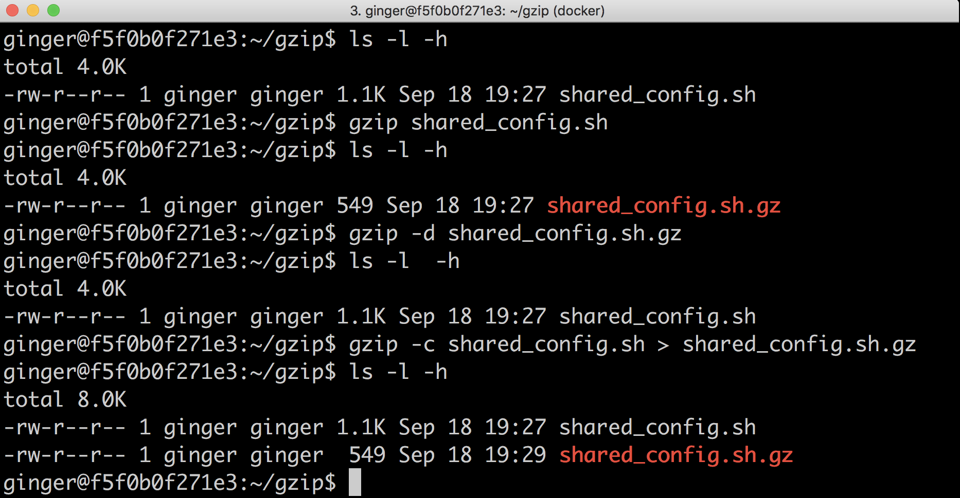
Compressing text files with gzip
Notes:
Basic gzip compression / decompression.

Slide 29
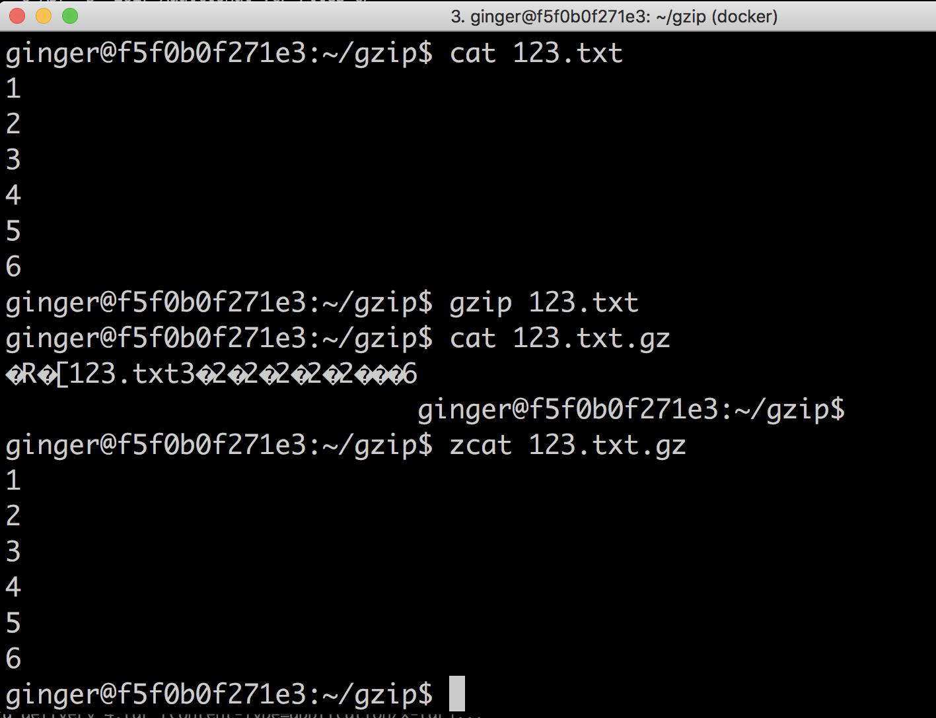
Working with gzipped files
cat -> zcat (gzcat on MacOS)
grep -> zgrep
less -> zless
For other tools, we need pipes!

Slide 30
Pipes

Slide 31
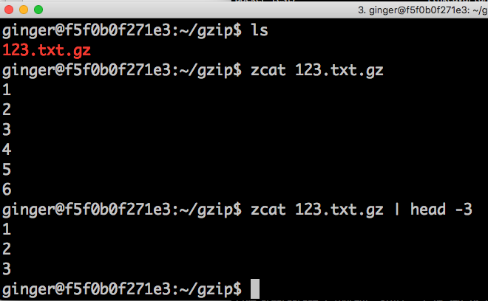
Pipe example: display 3 first lines of gzipped file
A pipe ( “|”) joins two commands together by taking the output (stdout) of the left command and sending it as input (stdin) to the right command.

Slide 32
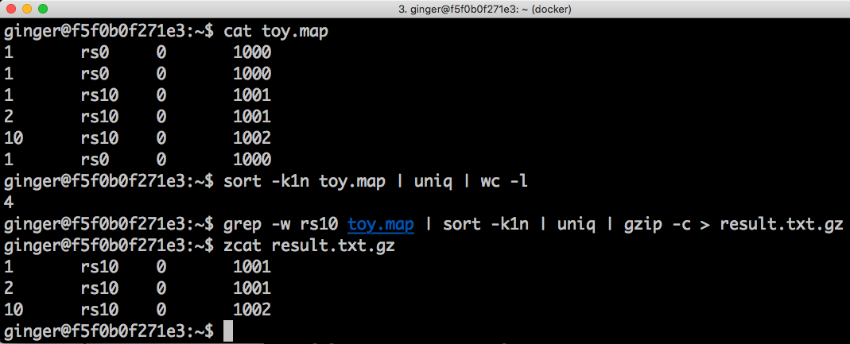
You can chain as many commands as you like with pipes

Slide 33
Pipes to find old commands
Look through your old commands
history | less
Find an old command you wrote that you knew had the word “find” in it
history | grep find

Slide 34
Disconnecting from a session to reconnect later
The most common tools are: screen and tmux
screen starts a new screen
Detach the window by holding control, and typing: ad
Then you can safely log off
Re-attach the window using: screen -r

Slide 35
Running large computations
On a cluster:
qsub: Sun Grid Engine
bsub: LSF
On the cloud:
dsub: Closest to a grid system like q/bsub. Some light setup required
Cromwell/WDL: requires a server to set up and bulky json/wdl files to run
Hail Batch (coming soon!): will be the easiest but not yet available

Slide 36
Going further
https://swcarpentry.github.io/shell-novice/
http://swcarpentry.github.io/shell-extras/

